Slide 1

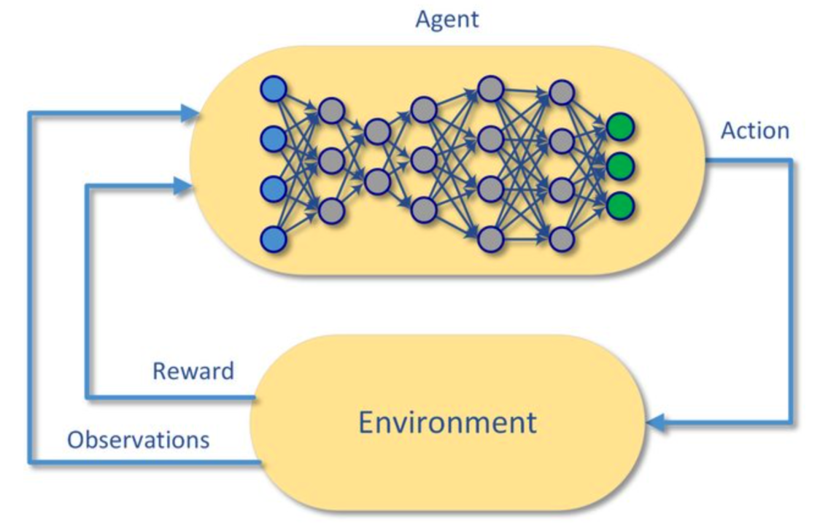
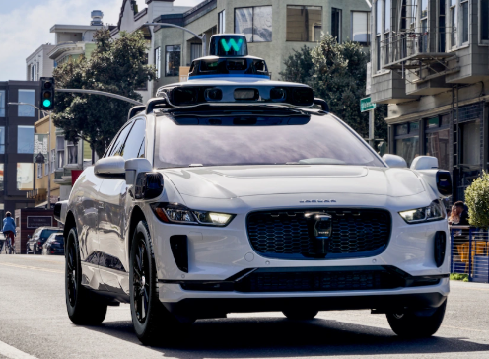
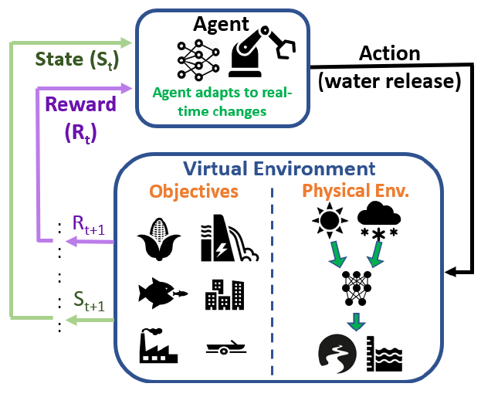
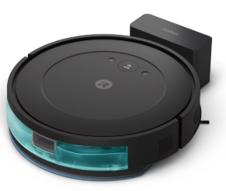
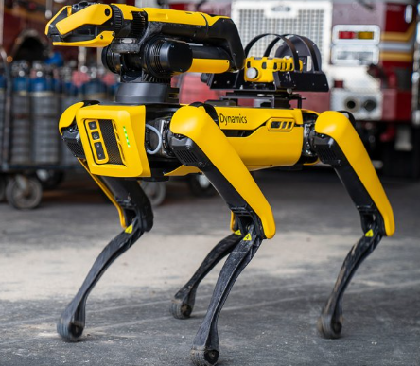

Deep reinforcement learning
Technical Vitality

Slide 2
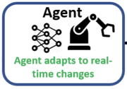
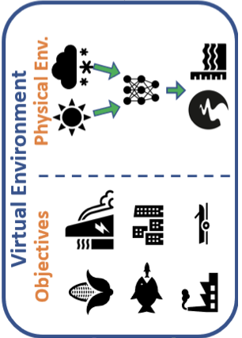

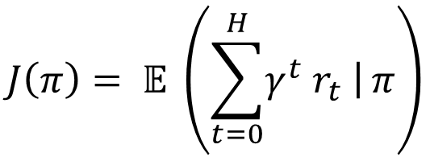
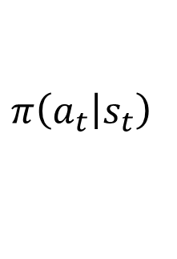
Deep Reinforcement Learning (DRL)
Goal of RL Agent: Learn a policy
Deep RL: Policy represented by NNs
How? Via interaction with the environment
Select action a_{t}
Environment evolves to S_{t+1}
Receive reward r_{t+1}
Objective: Maximize expected total discounted return
$$π\left(\left.a_{t}\right|s_{t}\right)$$
S_{t}
a_{t}
S_{t+1}
a_{t}
r_{t+1}
$$J\left(π\right)= 𝔼 \left(\sum_{t=0}^{H}{\left.γ^{t} r_{t} \right|}π\right)$$
Technical Vitality

